Slide 1
+
Idag
500ms
hon
300ms
läste
300ms
tidningen.
Time
300ms
???
Trigger
300ms
EEG recording
Until response
Notes:
Idag hon l\"aste tidningen

Slide 2
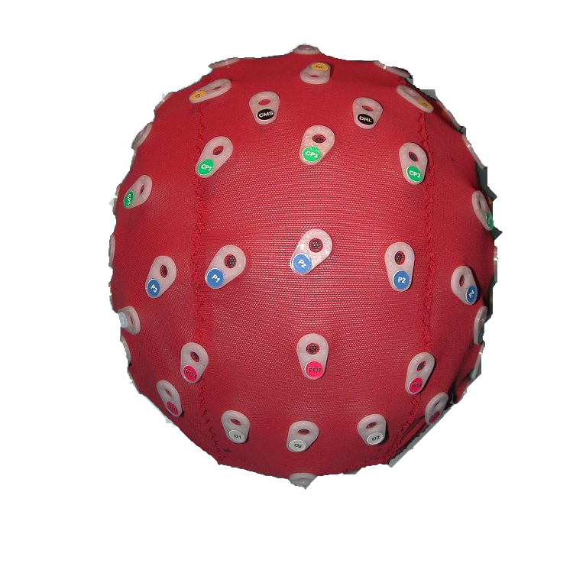
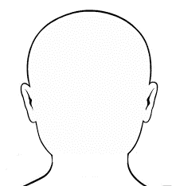
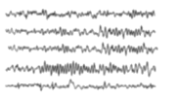
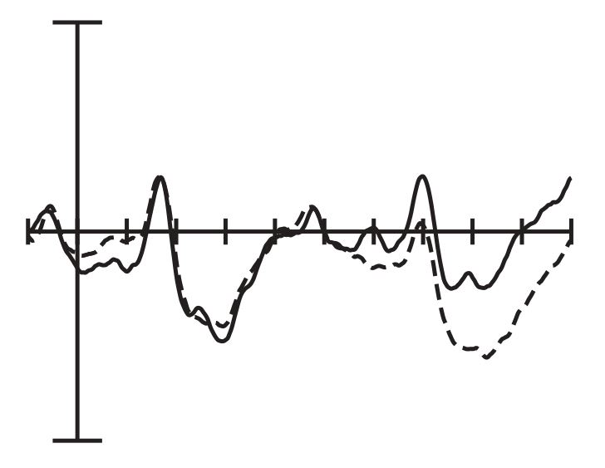
+
Fixation:500ms
Idag
Adverbial:
300ms
hon
Subject:
300ms
Time
läste
Verb:
300ms
+
tidningen.
Object:
300ms
???
Prompt:
Until response
Trigger:
Synced with onset of subject
EEG recording
Averaged ERPs
Notes:
Idag hon l\"aste tidningen

Slide 3
+
Fixation:500ms
Idag
Adverbial:
300ms
hon
Subject:
300ms
läste
Verb:
300ms
tidningen.
Object:
300ms
Time
???
Prompt:
Until response
Good
Bad
Notes:
Idag hon l\"aste tidningen

Slide 4
+
Fixation:500ms
Idag
Adverbial:
300ms
hon
Subject:
300ms
läste
Verb:
300ms
tidningen.
Object:
300ms
Time
Trigger to EEG:
Synced with onset of subject
???
Prompt:
Until response
Good
Bad
EEG recording
Averaged ERPs
Notes:
Idag hon l\"aste tidningen

Slide 5
+
Fixation:
500ms
Idag
Adverbial:
300ms
hon
Subject:
300ms
läste
Verb:
300ms
tidningen.
Object:
300ms
Time
???
Prompt:
Until response
Good
Bad
Acceptability judgment
Notes:
Idag hon l\"aste tidningen

Slide 6
+
Fixation
Dans notre famille, on est tous allergique à l’alcool :
personne ne boit rien dans les soirees
Read silently for comprehension
Dans notre famille, on est tous allergique à l’alcool :
personne ne boit rien dans les soirees
Press spacebar to begin recording
Dans notre famille, on est tous allergique à l’alcool :
personne ne boit rien dans les soirees
Read aloud for recording
Ils ne boivent pas d’alcool.
Read comprehension statement and respond
Time
True
False
Notes:
Idag hon l\"aste tidningen

Slide 7
hon
Trigger to EEG:
Synced with onset of subject
EEG recording
Averaged ERPs

Slide 8
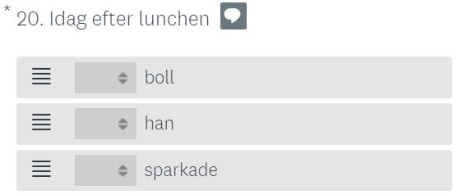
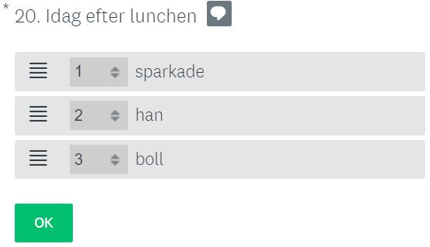

Slide 9
+
Fixation: 500-1000ms
Idag
Stimulus:
Until response / up to 1500ms
hon
Blank:
500ms
Time
Notes:
Stroop
Variable length fixation (500-1000)
Stim until response or up to 1500ms
Response keys on the screen
Blank 500ms
Rectangles
Black and white
Congruent color word
Incongruent color word

Slide 10
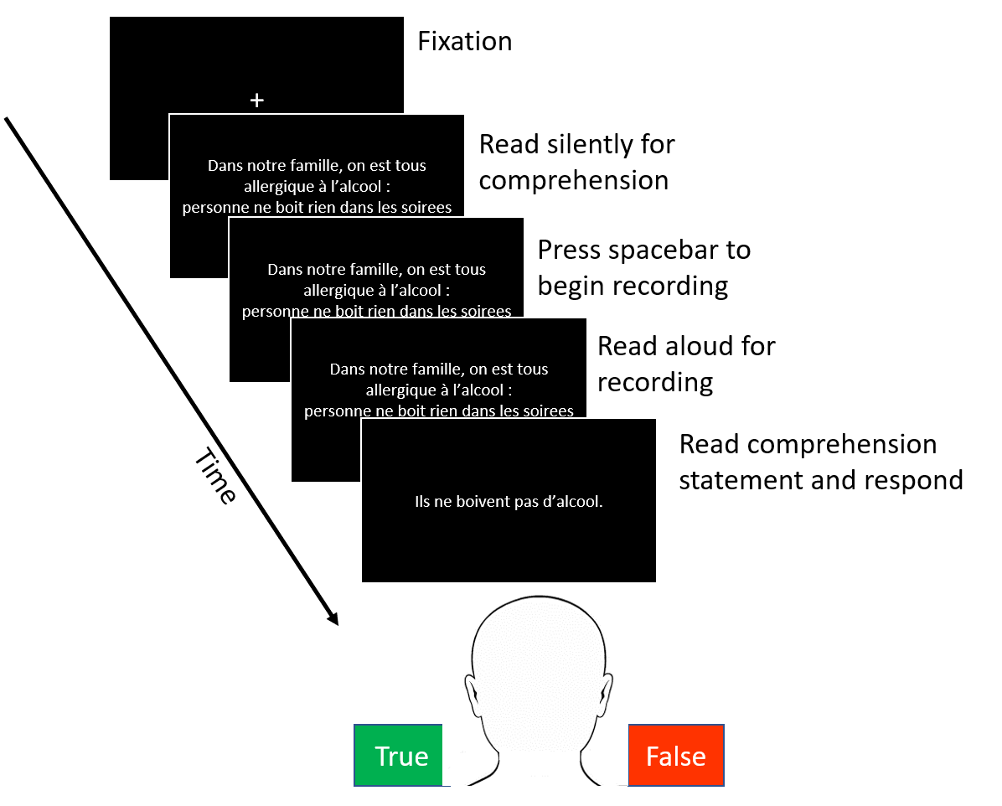
Notes:
Navon
Fixation variable length (500-1000)
Stimulus 250ms
Blank for 1250ms or until response
Blank 500 ms
Congruent global and local
Incongruent global and local

Slide 11

Context & sentence
Interpretation question
Recordings
Confidence rating
Stimulus
Response
Click on recording that matched interpretation
Space bar to proceed
True or False
5-point Likert scale
Metric
Confidence score
N/A
Context matching
DN/NC interpretation
Context matching
Interpretation matching

